Slide 1
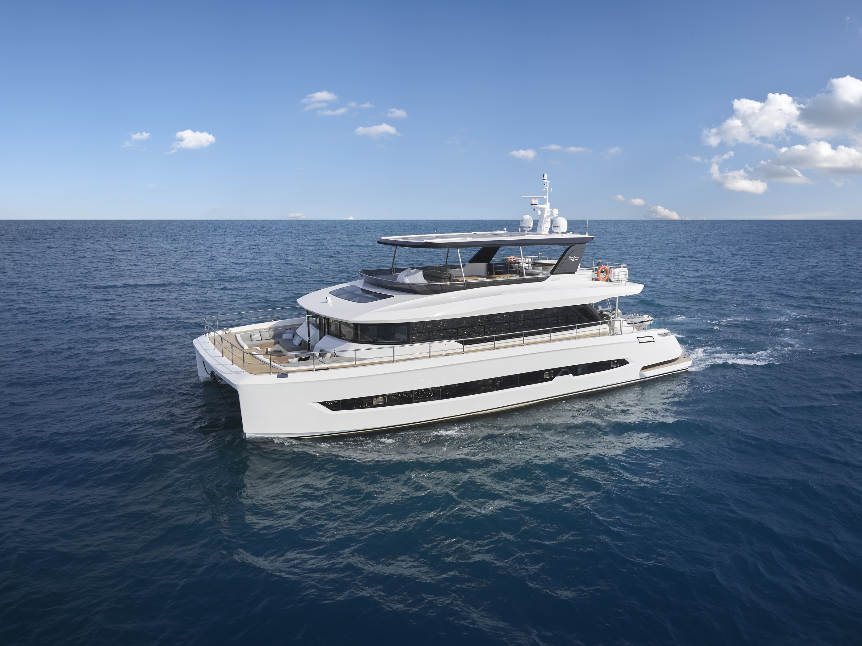


VISTA 75
SEAVIEW 56
Built by Heysea
Built by Heysea
Heysea Yacht Group Limited
Website: www.heyseayacht.com
Email: sales@heysea.com

Slide 2
VISTA 75
Built by Heysea

Slide 3
LUXURY UNVEILED
EMBRACING SPACIOUS GRANDEUR
Vista 75 stands as a testament to luxury, comfort, and innovation on the water. From its impressive dimensions to its meticulously designed spaces, every aspect of this yacht has been crafted to exceed expectations and provide an unparalleled yachting experience.
Featuring spacious outdoor areas and thoughtful amenities, Vista 75 surpasses all expectations for a yacht of its size. Whether basking in the sun on the foredeck, enjoying a meal with loved ones, or exploring the mysterious charm of the sea, every moment aboard the Vista 75 is an unforgettable adventure.From its serene flybridge to its luxurious owner's cabin,every detail has been meticulously crafted to provide unparalleled comfort and enjoyment for owners and guests alike.
Embark on a journey of luxury and relaxation aboard the Vista 75, and
discover the true essence of yachting excellence.

Slide 4
FREE YOUR LIFE

Slide 5
FLYBRIDGE
The flybridge deck emerges as a tranquil oasis, inviting you to unwind and socialize in luxurious surroundings.Unwind in captivating spa, where the gentle ocean breeze invites you to escape the stresses of everyday life and embrace tranquility. Marvel at the breathtaking BAR counter enveloping the spa, offering unparalleled views that stretch beyond the horizon and set the stage for unforgettable
moments.
At BBQ and Refreshment center, tantalizing flavors await to delight your palate. As night descends, recline on daybed under the twinkling stars visible through the skylight,
enjoying the magic moment.
For adventurers, flybridge offers the thrill of navigating the open seas from extra-large helm seating, perfect for couples embarking on unforgettable voyages. With impeccable docking vision, maneuvering the vessel with
confidence is effortless.

Slide 6

LUXURY UNVEILED:
EMBRACING SPACIOUS GRANDEUR
Vista 75 stands as a testament to luxury, comfort, and innovation on the water. From its impressive dimensions to its meticulously designed spaces, every aspect of this yacht has been crafted to exceed expectations and provide an
unparalleled yachting experience.
Featuring spacious outdoor areas and thoughtful amenities, Vista 75 surpasses all expectations for a yacht of its size. Whether basking in the sun on the foredeck, enjoying a meal with loved ones, or exploring the mysterious charm of the sea,
every moment aboard the Vista 75 is an unforgettable adventure.From its serene flybridge to its luxurious owner's
cabin,every detail has been meticulously crafted to provide unparalleled comfort and enjoyment for owners and guests alike.
Embark on a journey of luxury and relaxation aboard the Vista 75, and discover the true essence of yachting excellence.

Slide 7
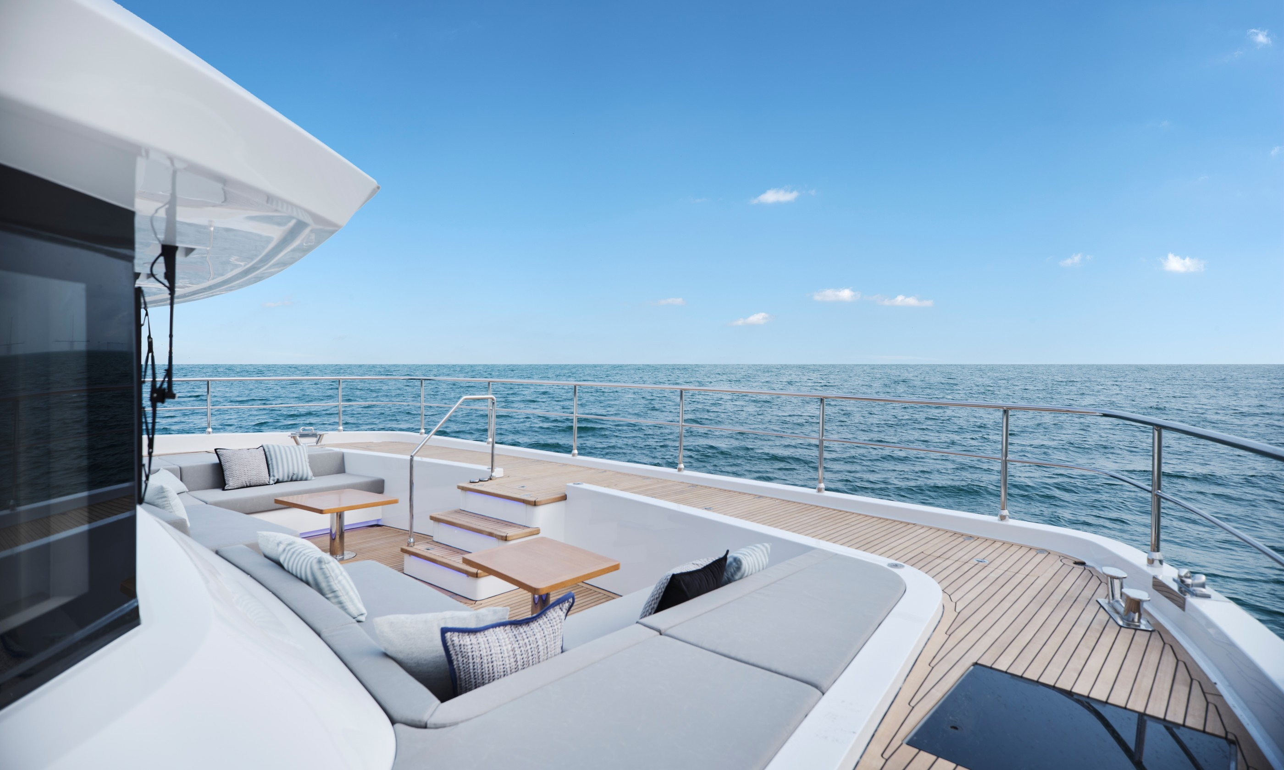
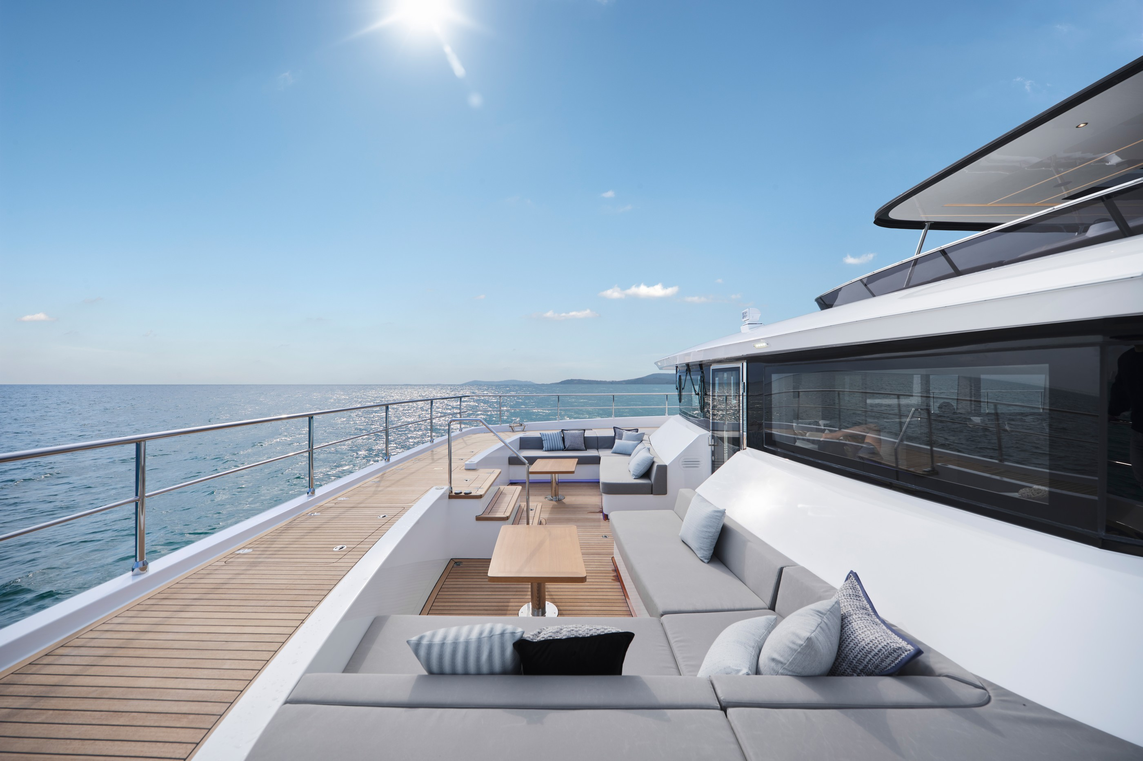
FOREDECK
Step onto the foredeck, meticulously crafted for an unparalleled
outdoor experience.
Integrated poles effortlessly create a fully shaded area, providing sophisticated retreat from the sun. This innovation ensures
comfort for all onboard.
Safety is paramount, especially in the seating area. Meticulous design caters to pets and children, offering peace of mind to all passengers.
Access is seamless, facilitating anchoring and boat handling with efficiency. Whether you're a seasoned sailor or a novice, navigating
this space is intuitive.

Slide 8
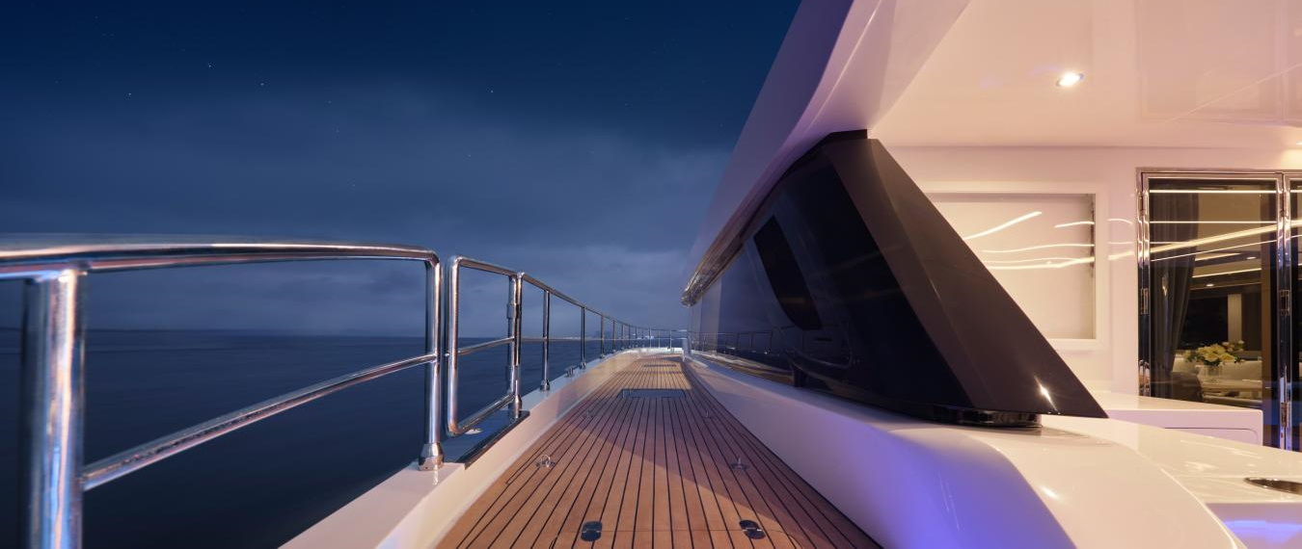
For uninterrupted relaxation, crew access is discreetly located,
providing a separate haven for peaceful enjoyment.

Slide 9
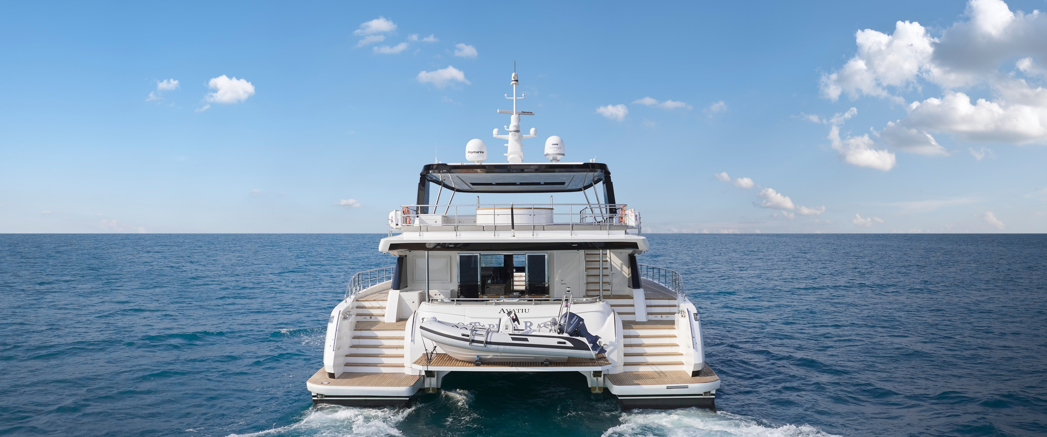
AFTDECK
Adding to the outdoor experience is the hydraulic swim platform on the aftdeck, which offers versatility by expanding the social area when raised and seamlessly integrating with the diving platform when
lowered.

Slide 10
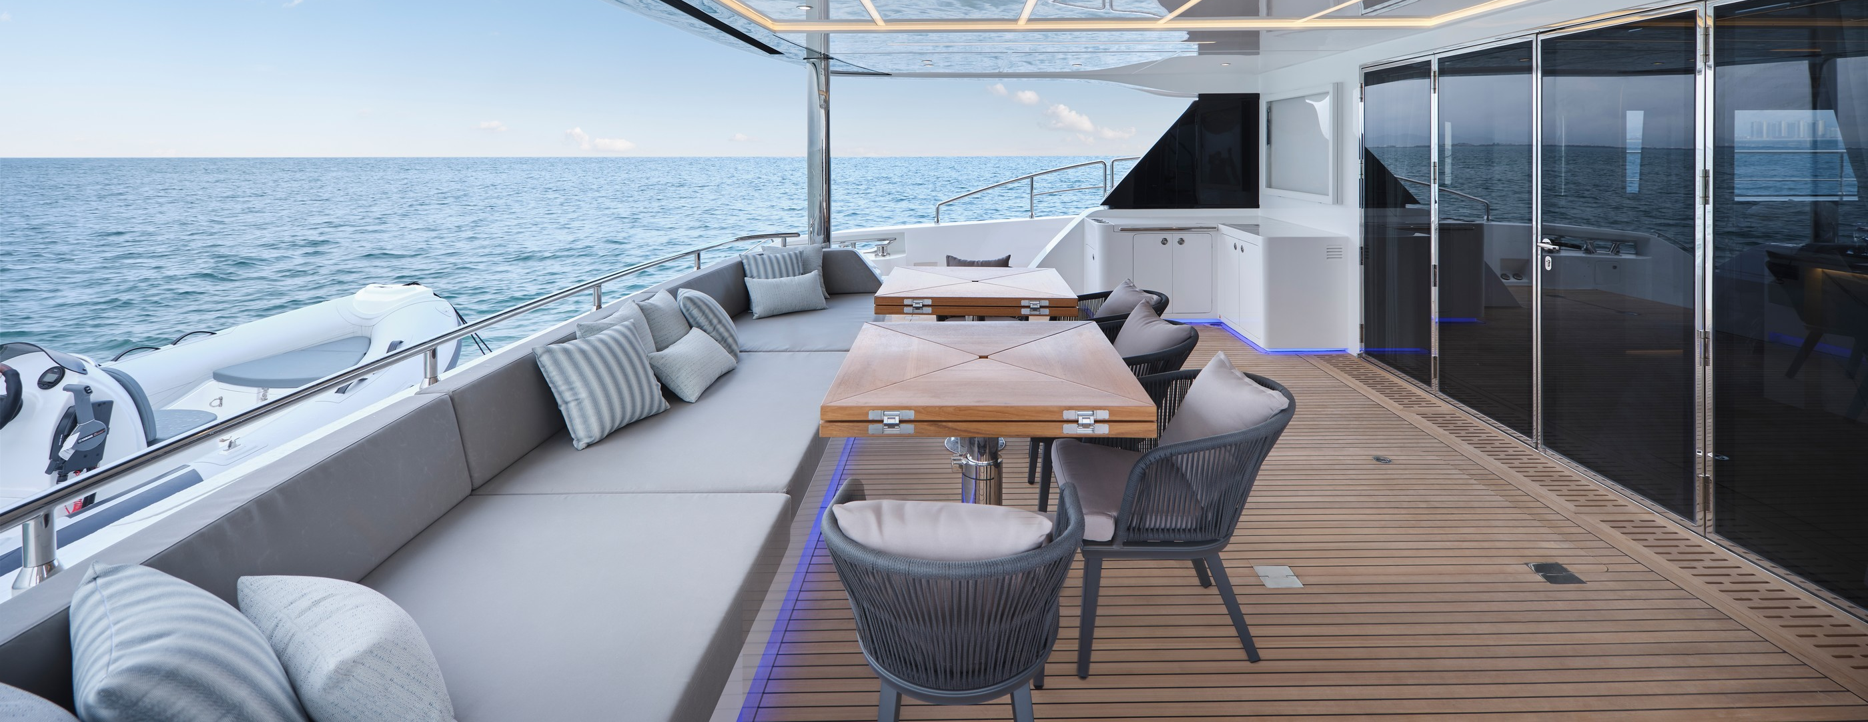

Slide 11
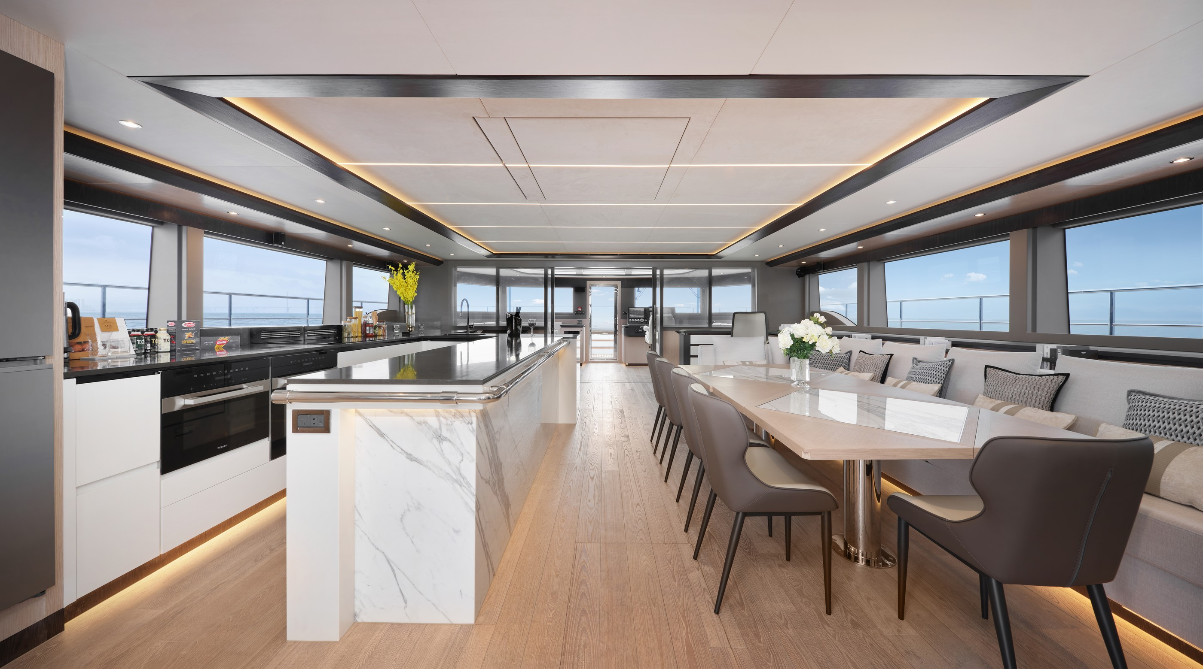
MAIN DECK
Surrounded by glass windows, the salon is bathed in natural light from every angle. Front and rear dual-sliding glass doors beckon guests to seamlessly transition from the salon to the foredeck or aftdeck, inviting them to discover the mysterious charm of the sea. The kitchen island takes center stage in the salon, creating a welcoming space for friends and family to gather comfortably while preparing food or enjoying a glass of
wine.

Slide 12
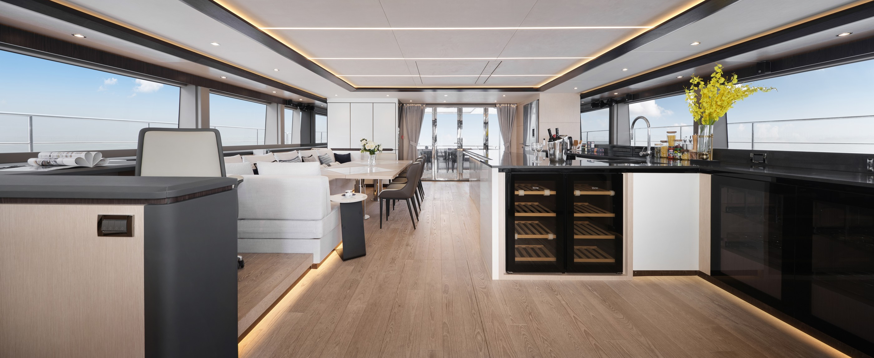

Slide 13
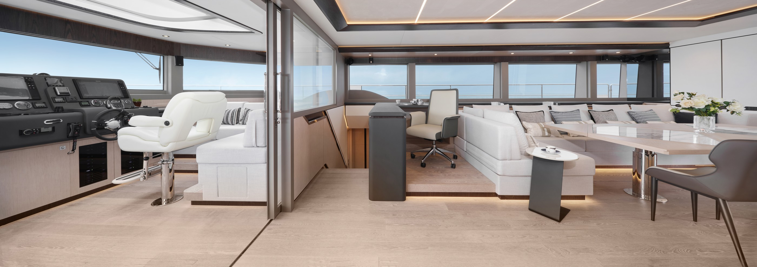

Slide 14
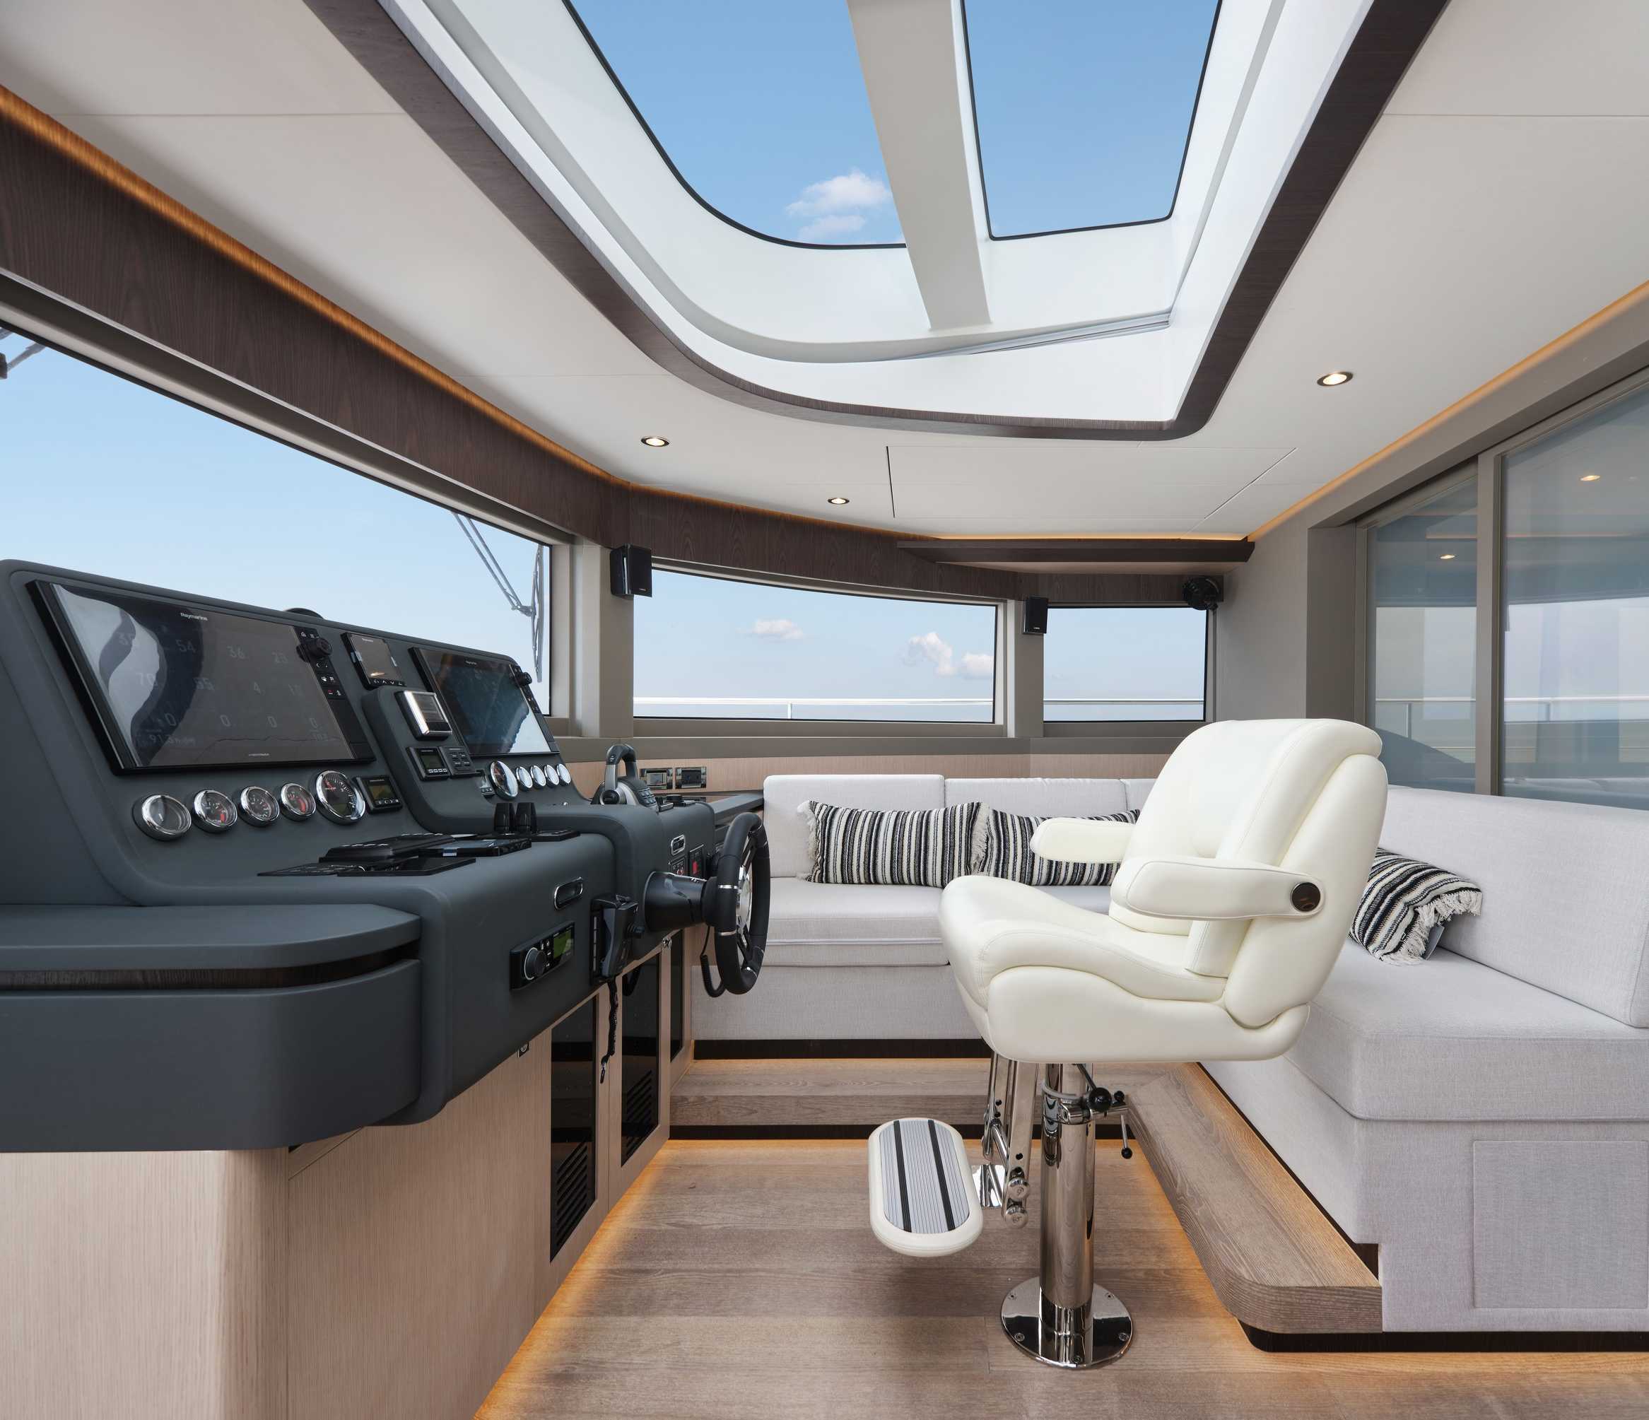
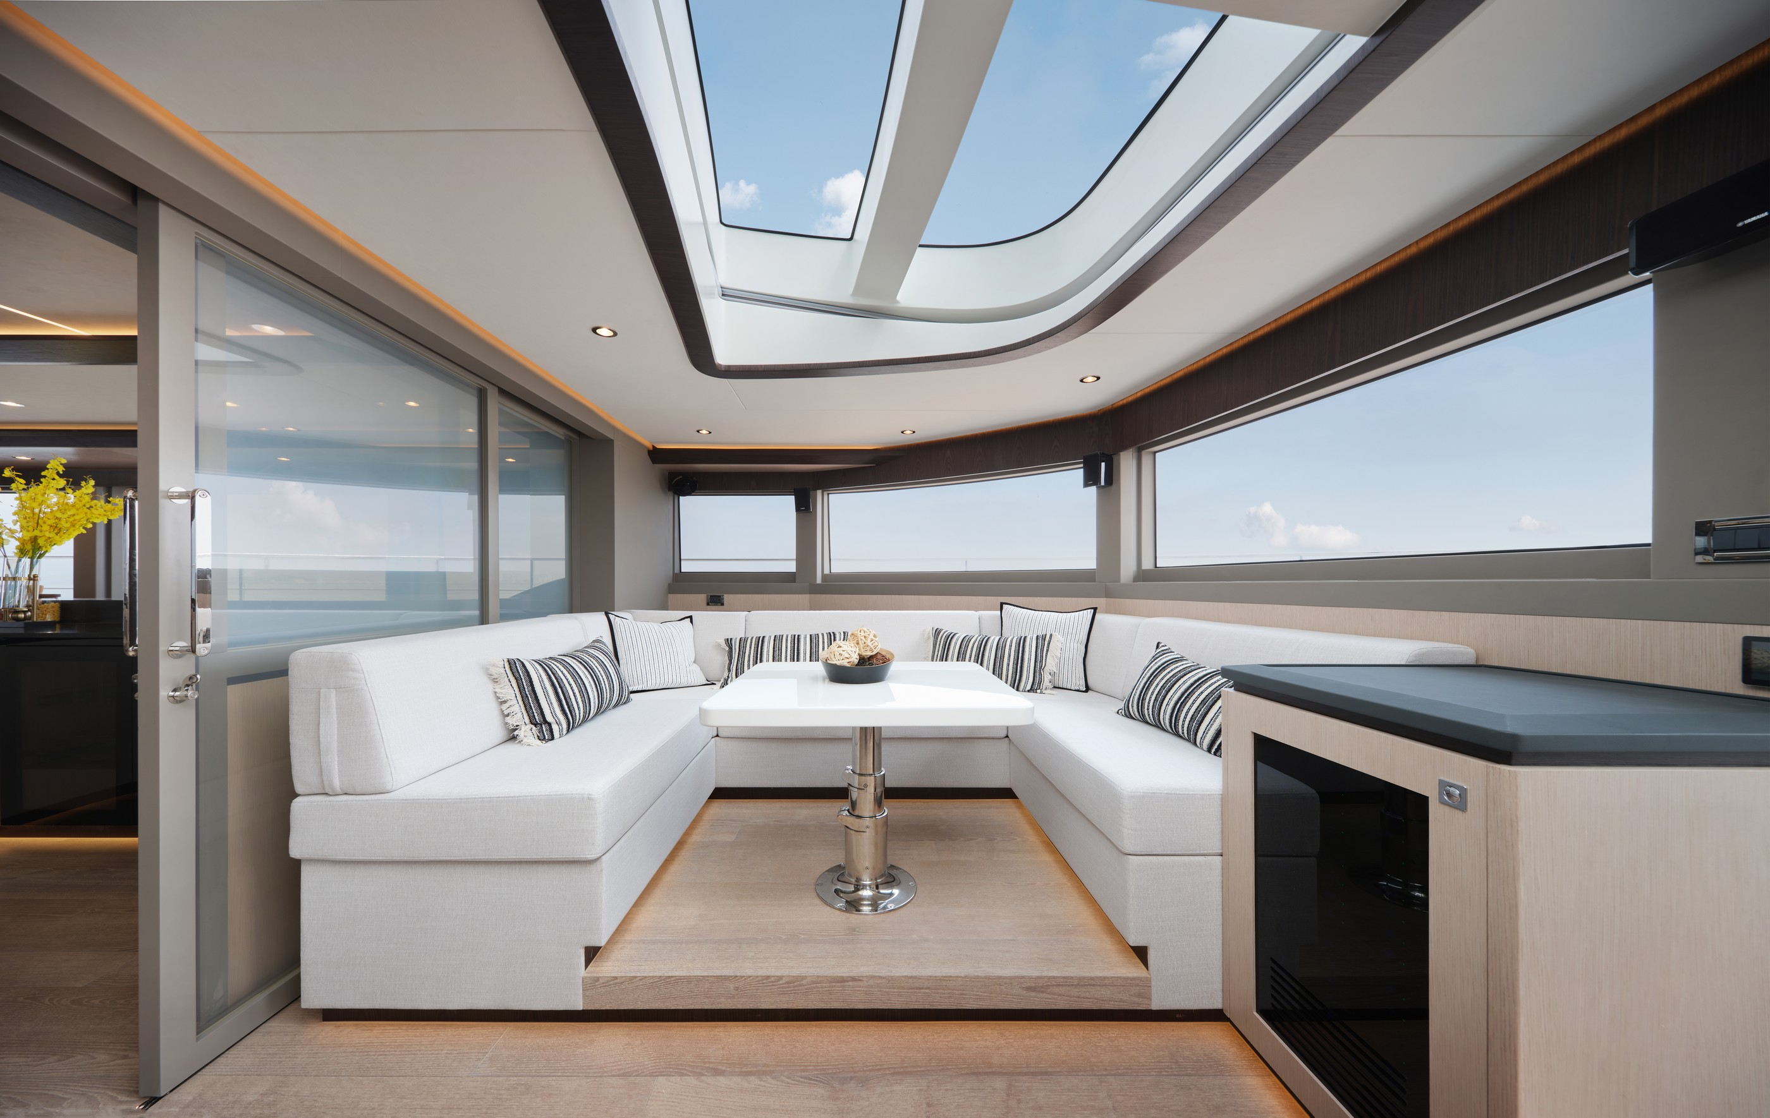

Slide 15
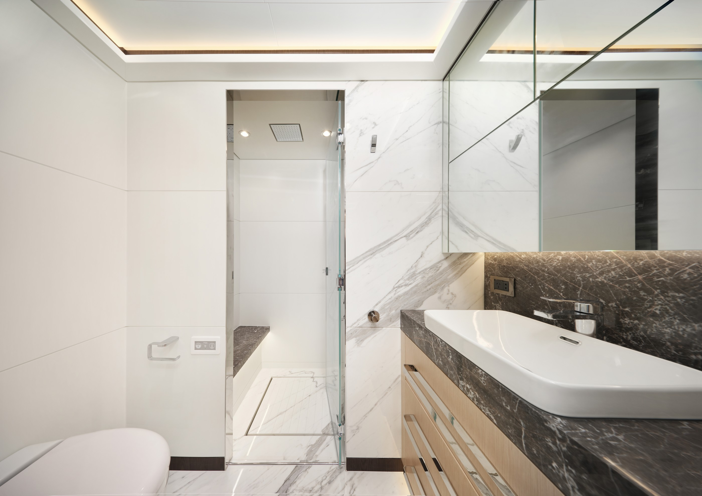
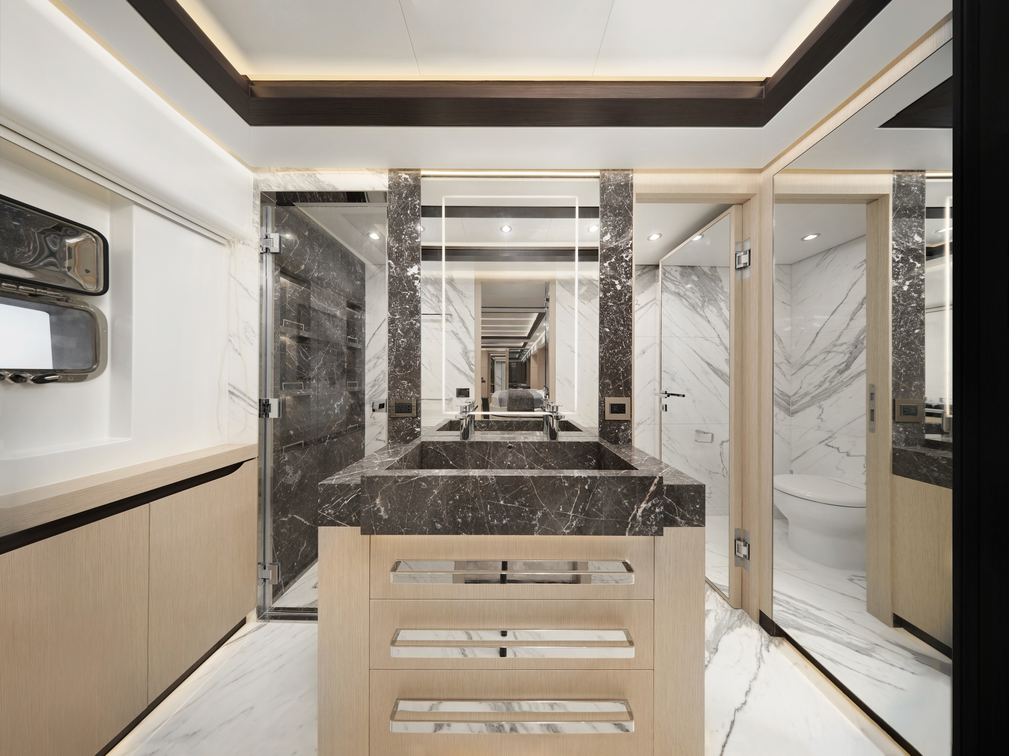
LOWER DECK
The lower deck is designated as a private living space for the owner and guests. The owner's cabin is a marvel, featuring amenities such as a TV, dressing table, bar fridge, and a working table. This space serves not only as a bedroom but also as
a home office.
Guest cabins are thoughtfully designed with a walk-in wardrobe, lounge area, and an independent bathroom. Every detail in the design reflects meticulous attention, providing a hotel-like experience where only the subtle sound of waves serves as a reminder that owner and guests are at
sea.

Slide 16
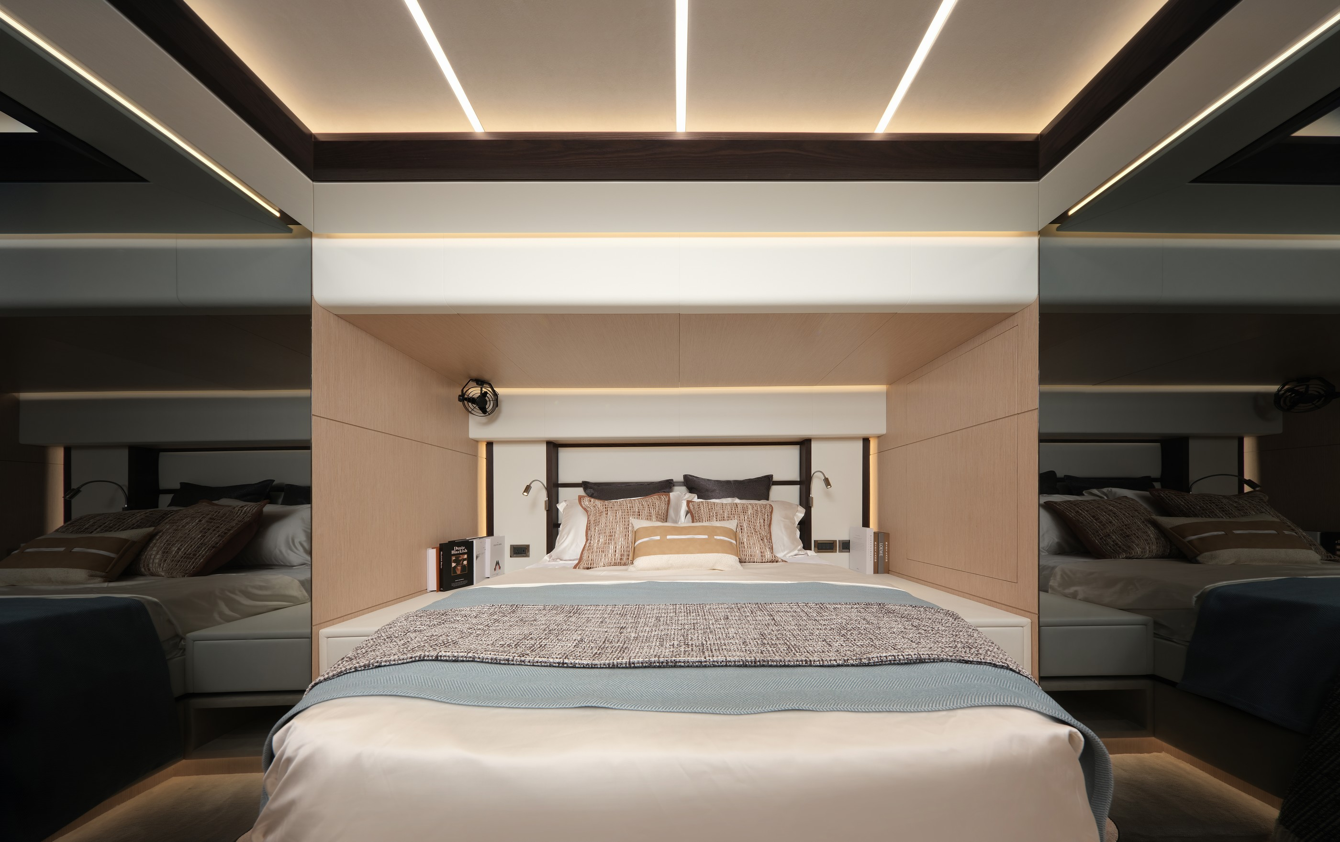
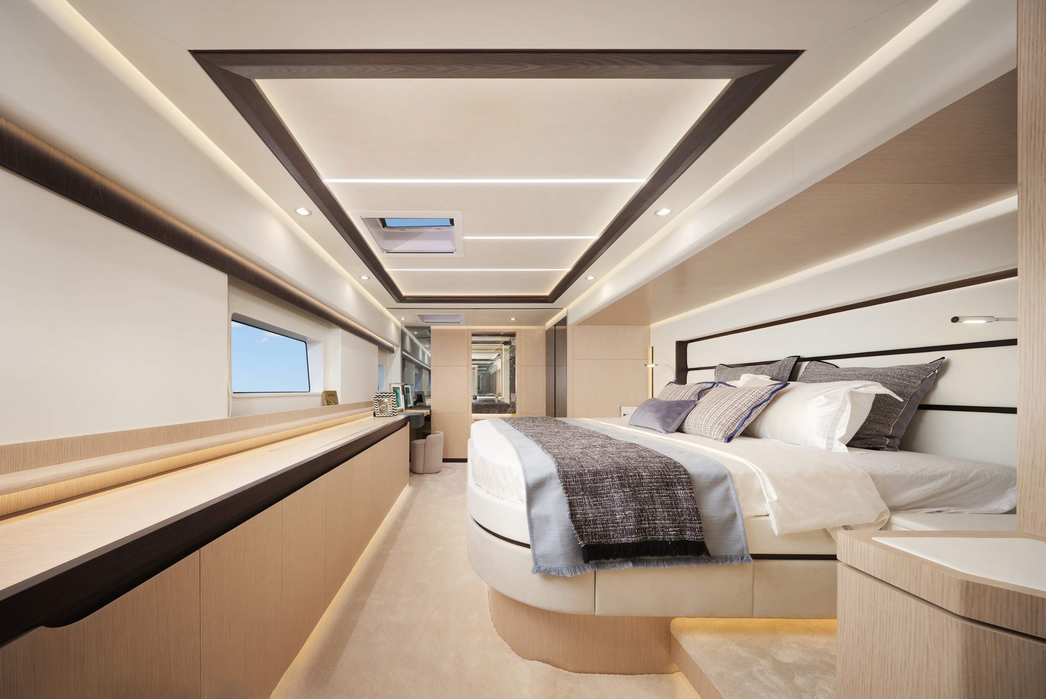

Slide 17
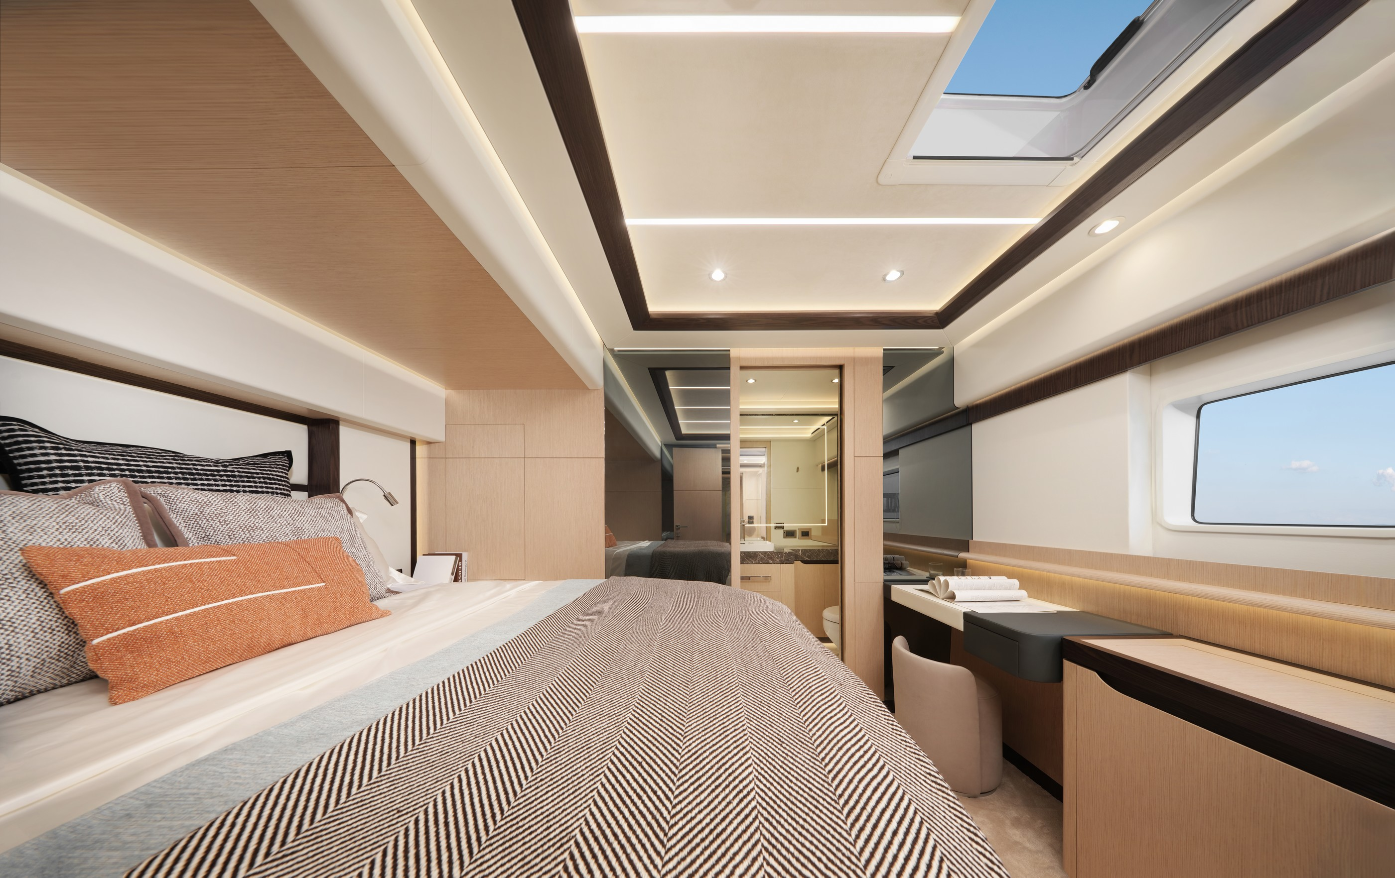


Slide 18
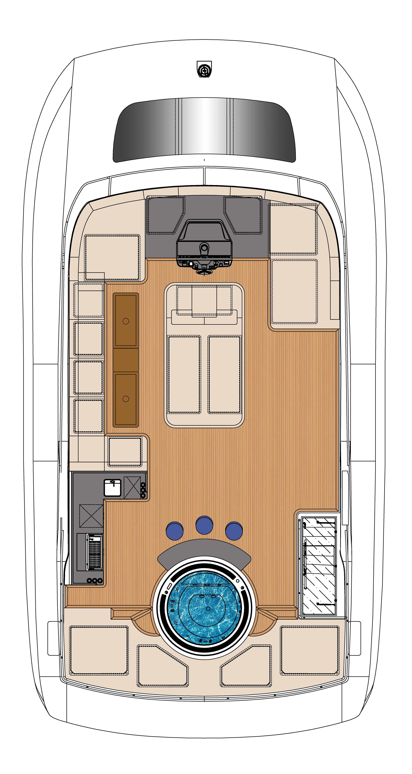
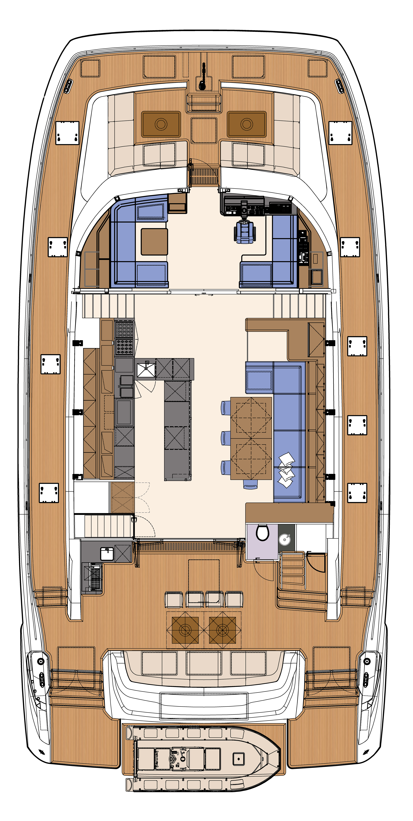
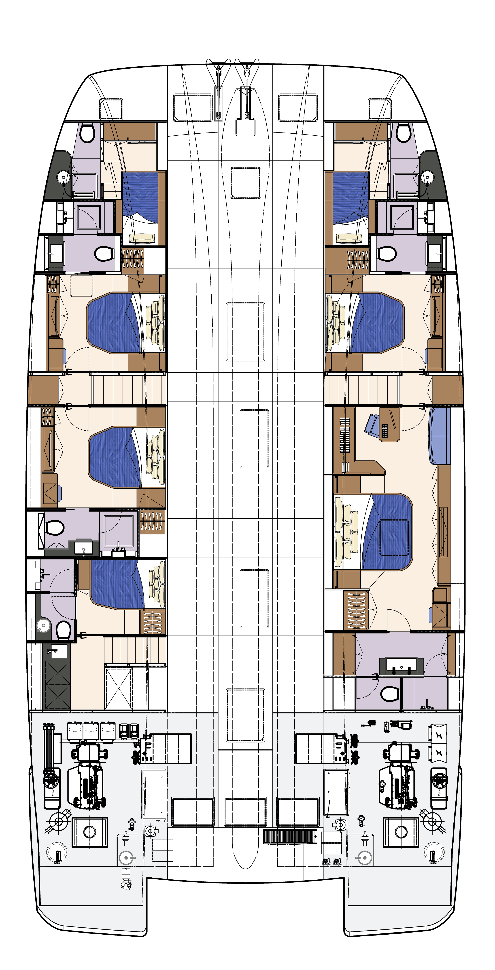
OPTION A
Flybridge
Main Deck
Lower Deck

Slide 19
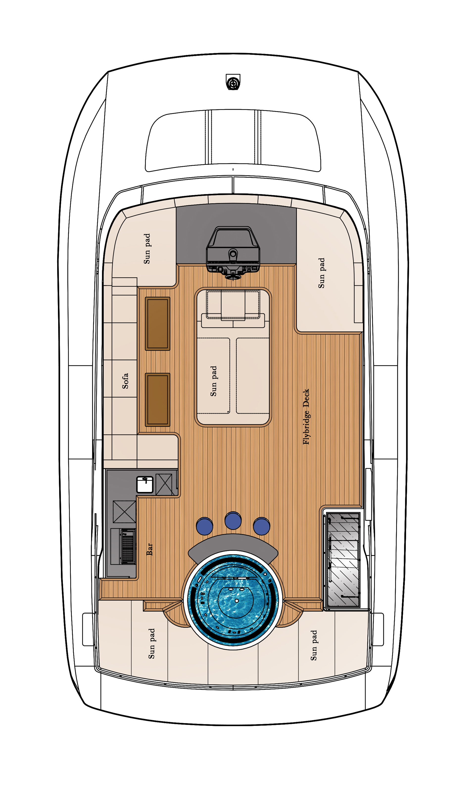
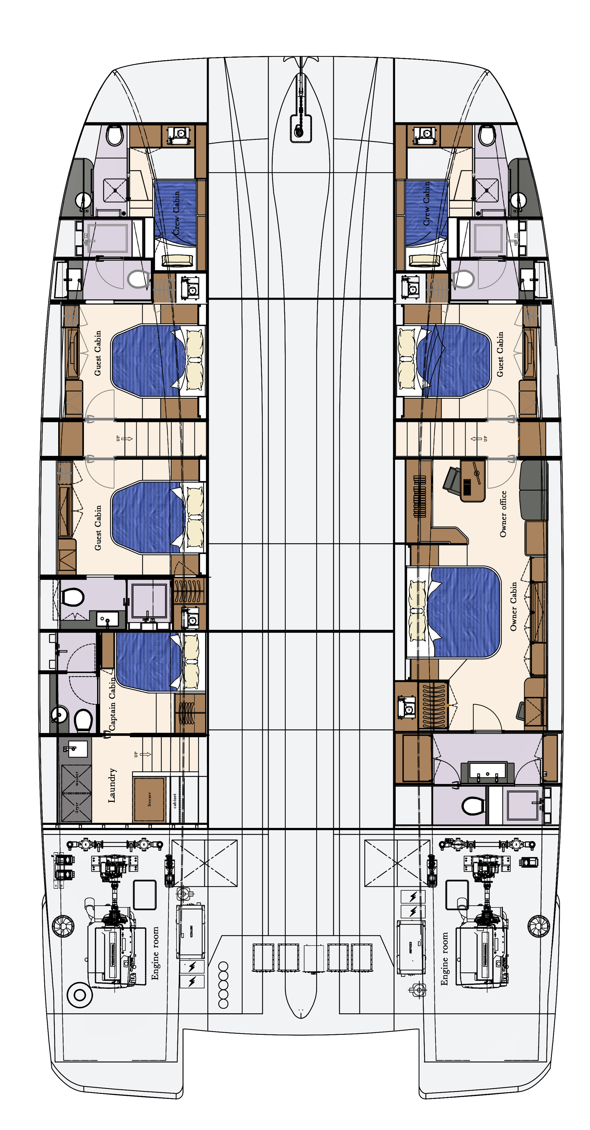
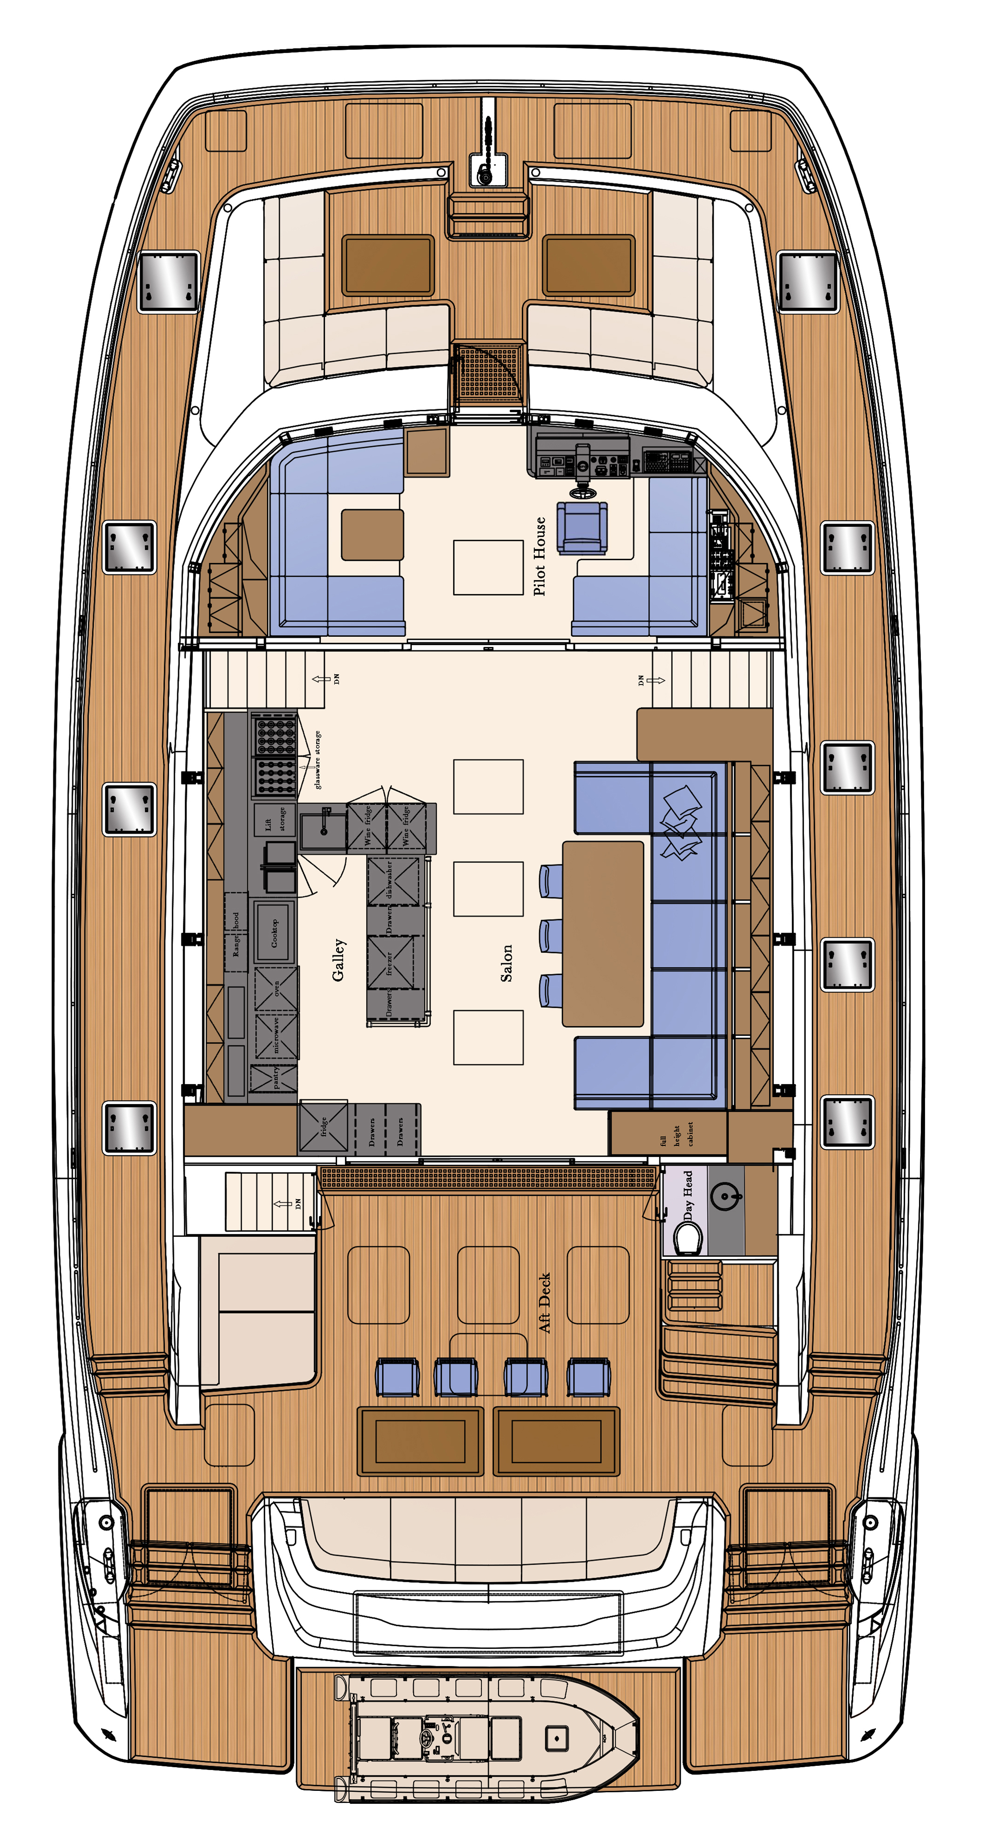
OPTION B
Flybridge
Main Deck
Lower Deck

Slide 20
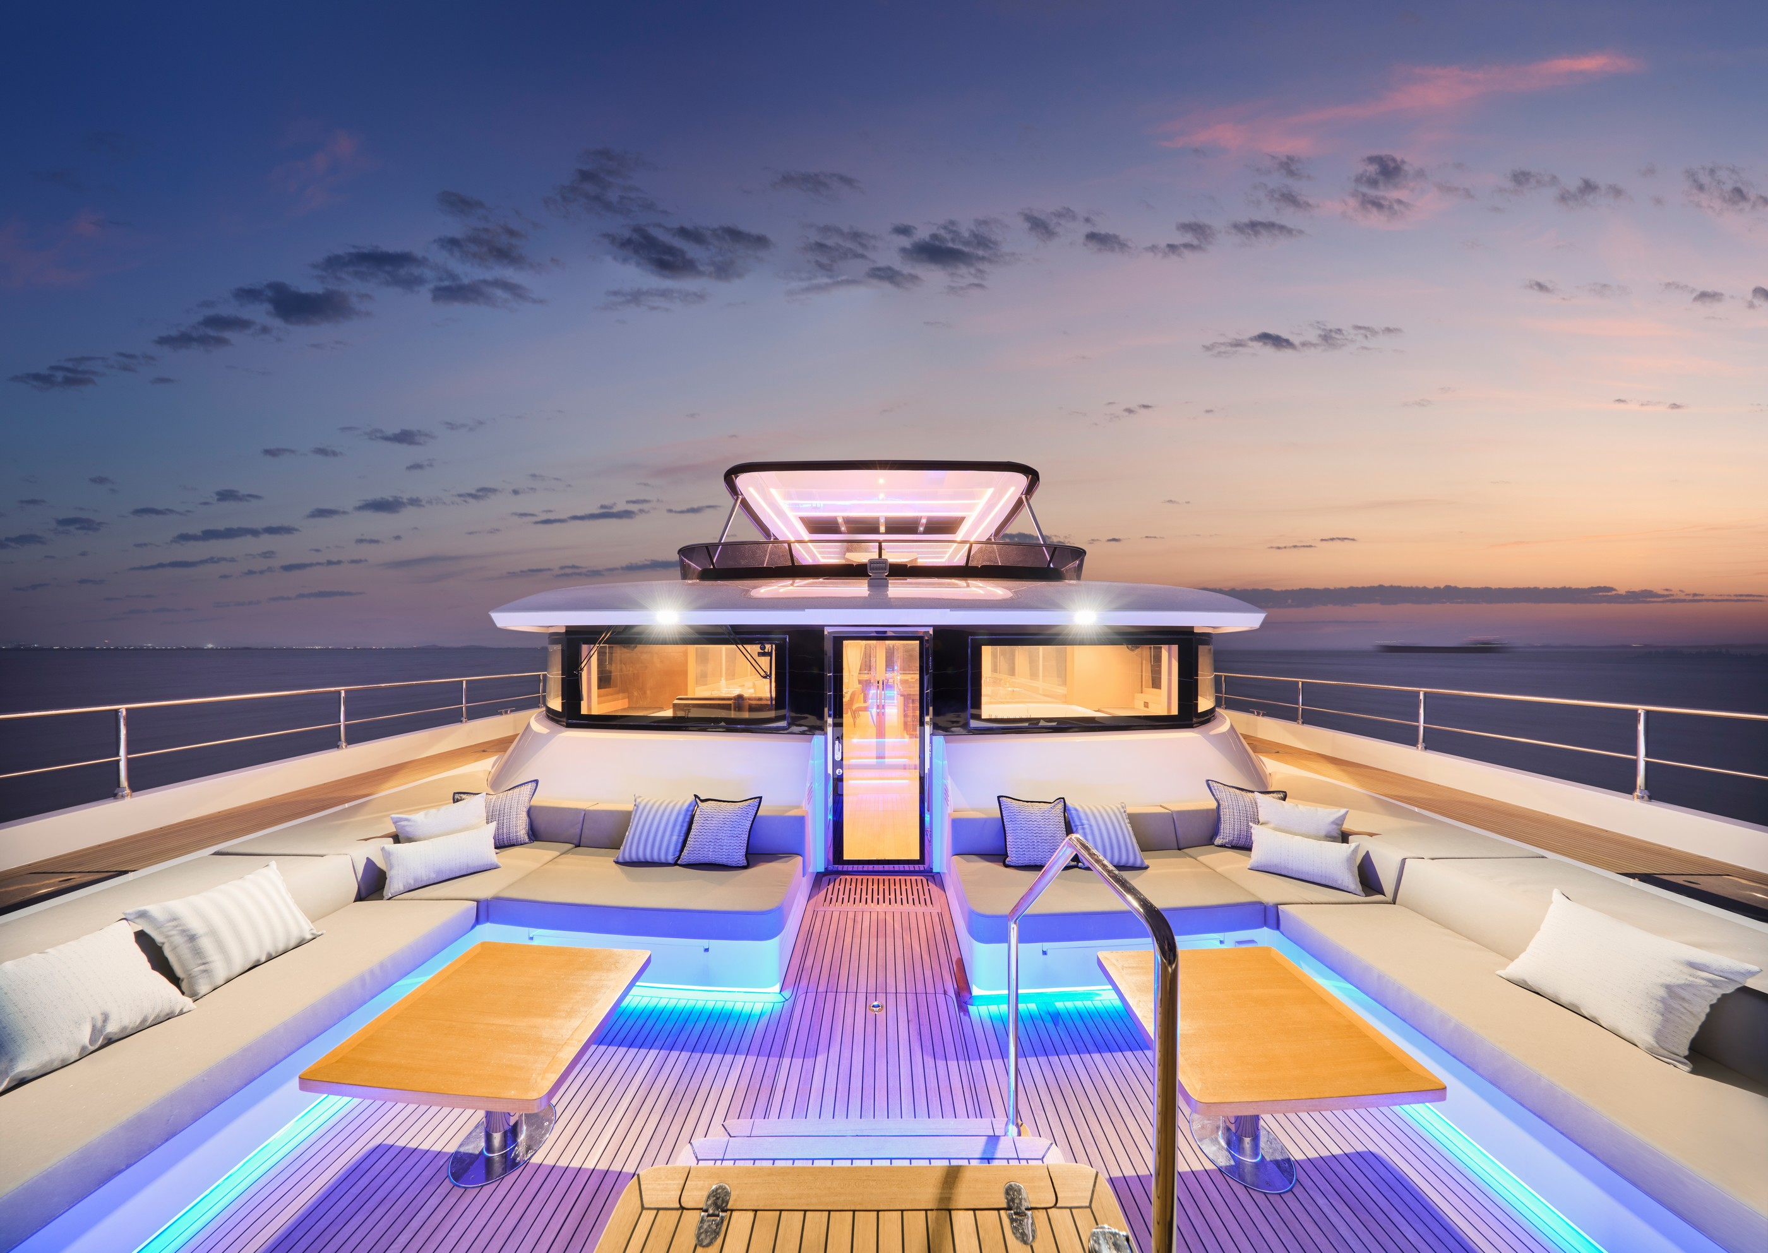
VISTA 75
Built by Heysea
SPECIFICATION
Length overall: 22.88M (75’0‘’）
Beam: 11.28M (37’0‘’）
Draft at Half Load: 1.64M (5’4‘’）
Displacement at Half Load: 90MT(198,416LBS)
Gross Tonnage: 148GT
Main Engine: 2 × VOLVO D13-1000HP
Fuel Capacity: 10,000 Ltrs（2,642 US Gal.)
Fresh Water: 1,500Ltrs（396 US Gal.)
Max Speed: 20 Knots
Range: 2000NM@8Knots
Guests and Crews: A:12;B:18;C:24
Generators: 2 × Kohler 28KW
Material: GRP
Classfication: CE Certified
Builder: Heysea Yachts
Exterior and Interior Design: Paolo Dose

Slide 21
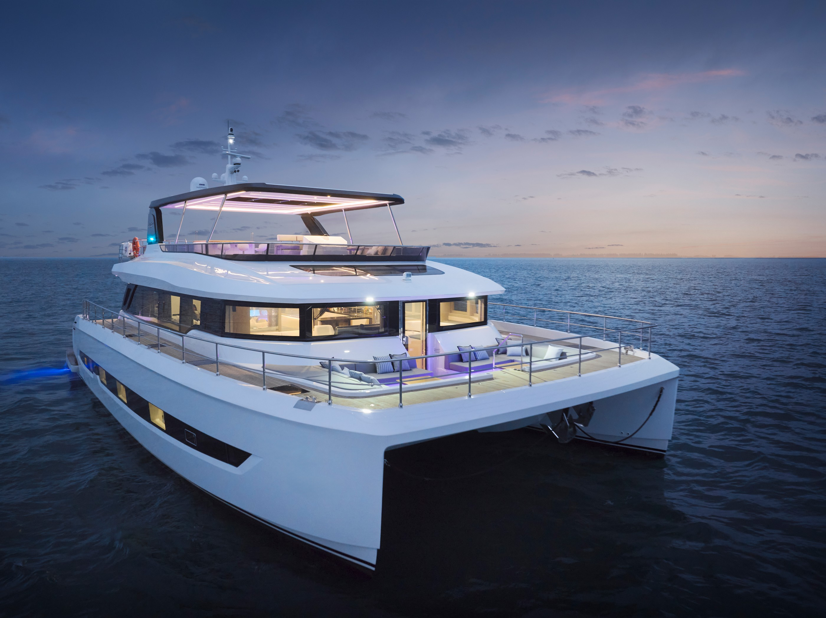
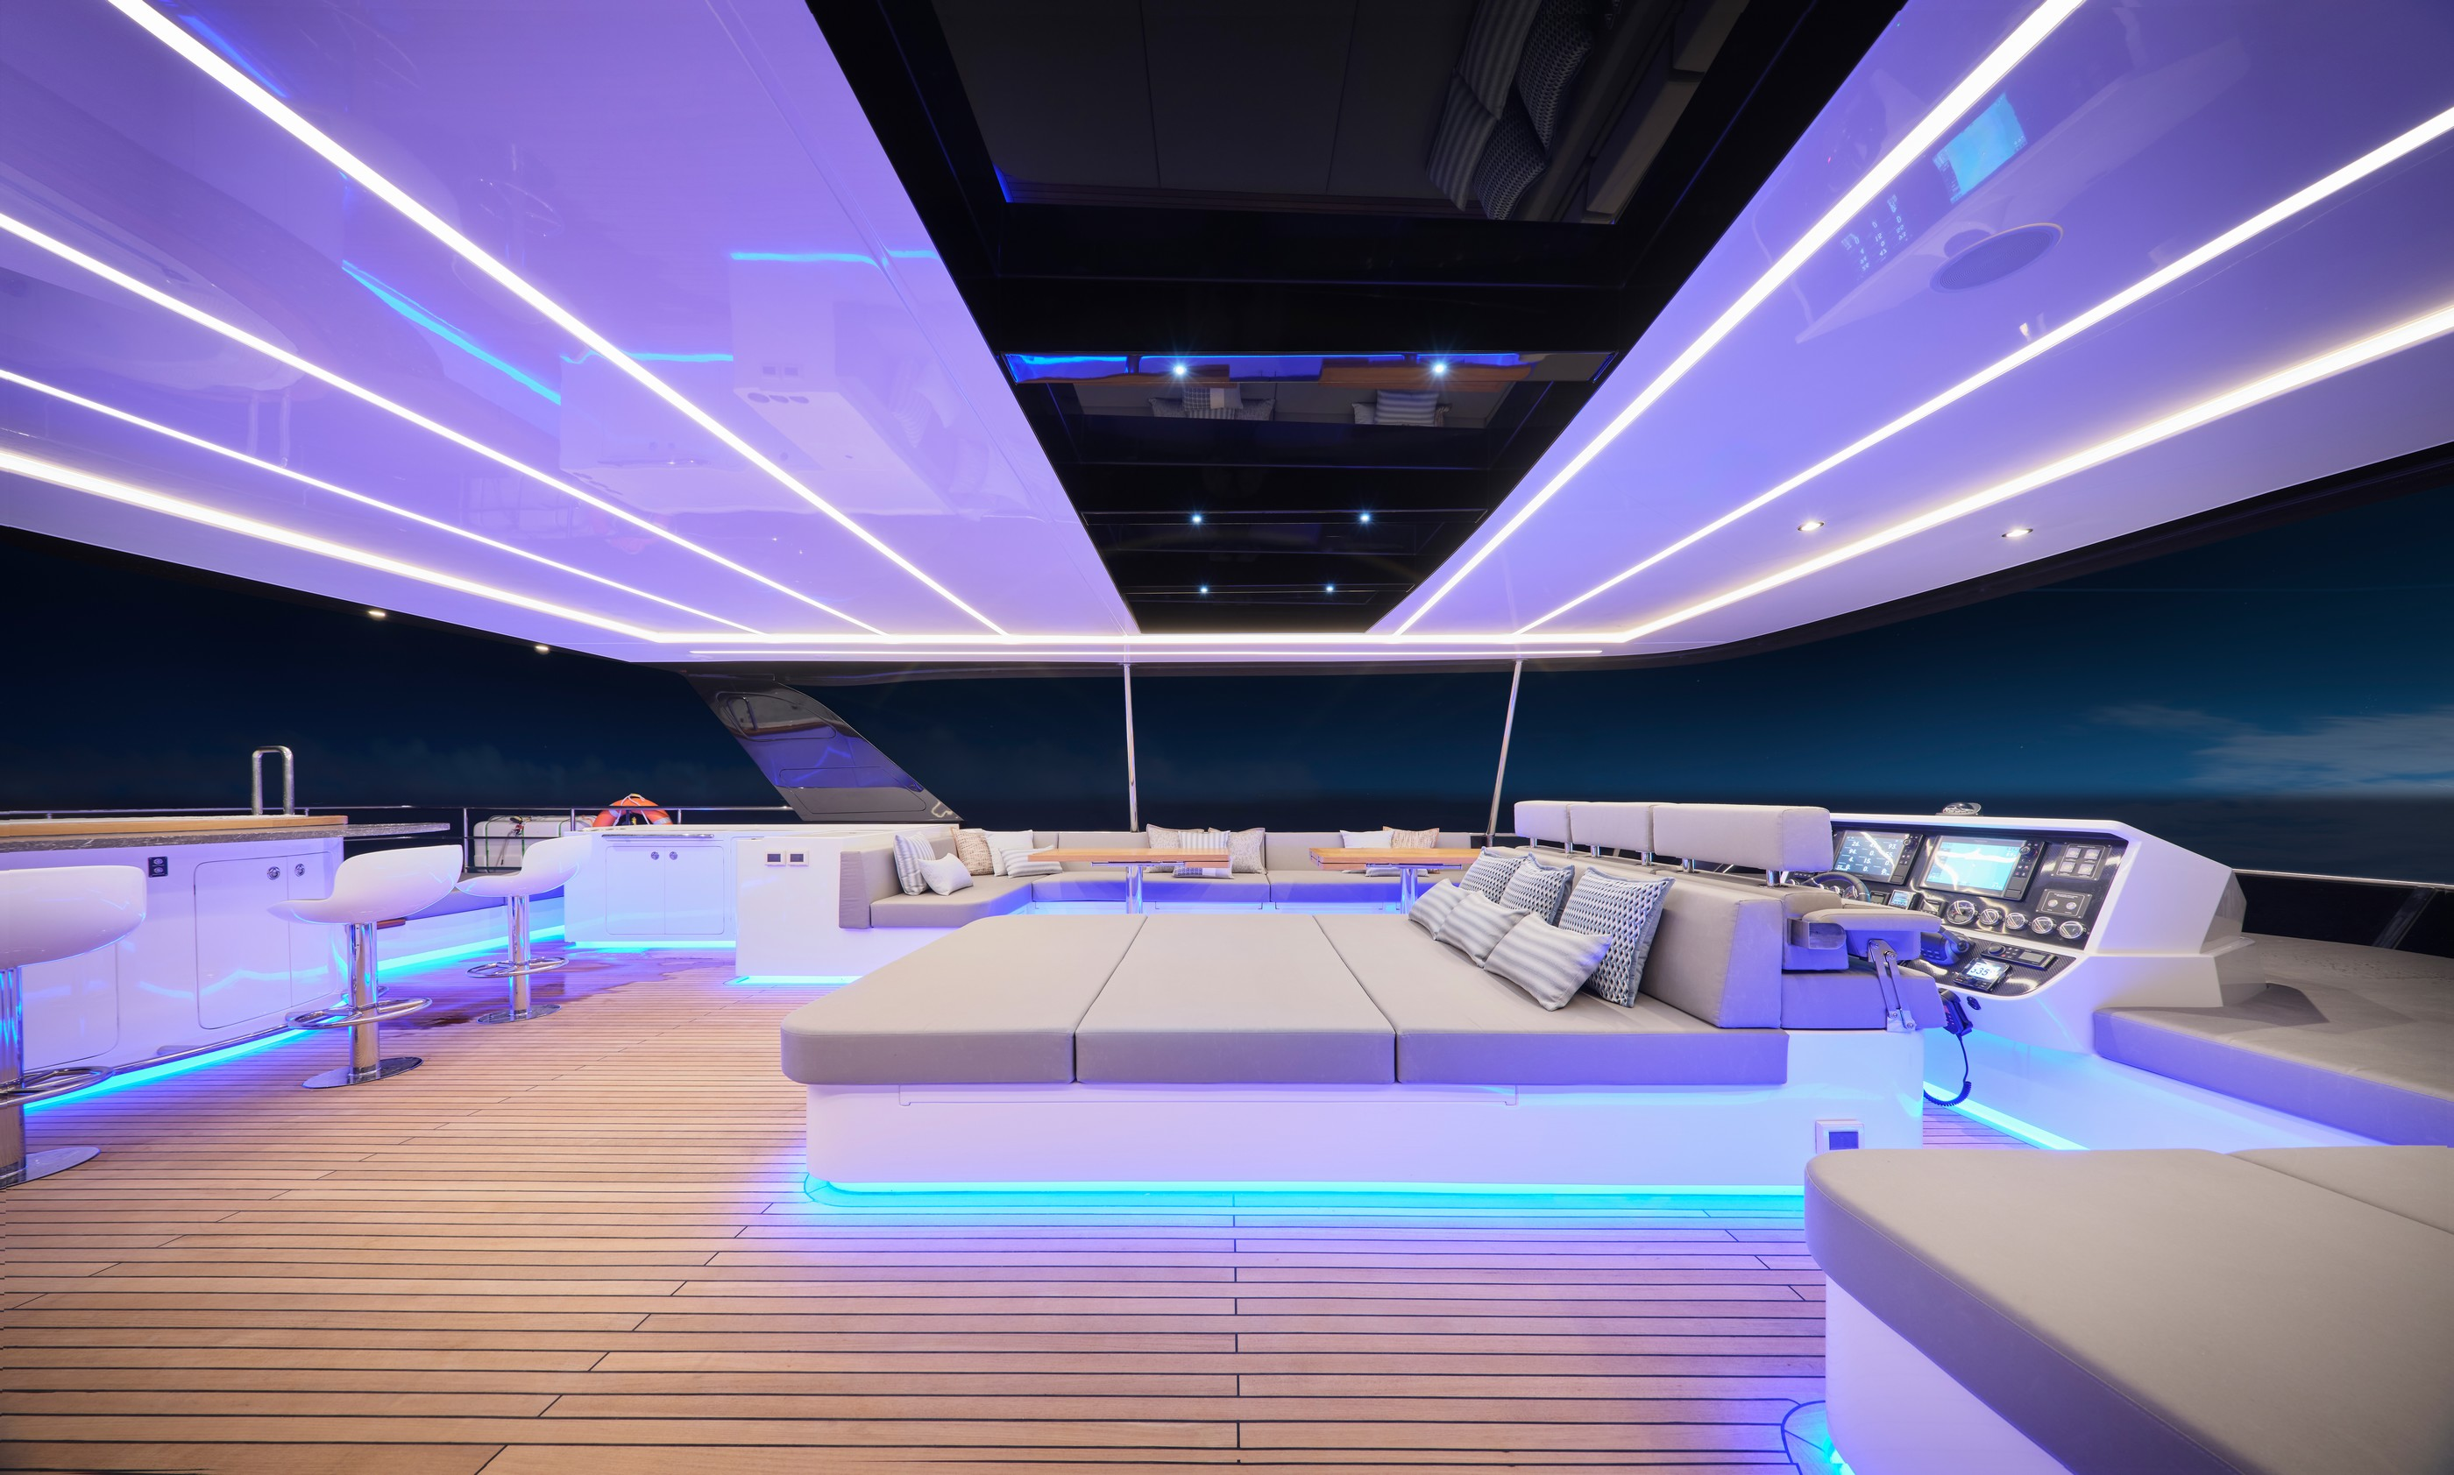

Slide 22
FREE YOUR LIFE

